Slide 1
Reverse Engineering With SDR
Ryan Eslick, Austin Brown, Hunter Griffin, Carter Church, Daniel Bangham
Notes:
Carter C

Slide 2
Reverse Engineering - Black Box vs White Box Refresher
Black Box - Internal details (design, functionality, etc) are left unknown to the reverse engineer; Opposite of white box.
Specifically, our project revolves around documenting the process for performing black box reverse engineering on a device emitting RF signals.
For us, this entails having no formal understanding of the device, then reverse engineering its communication processes solely from captured wireless transmissions.
Notes:
Carter C

Slide 3
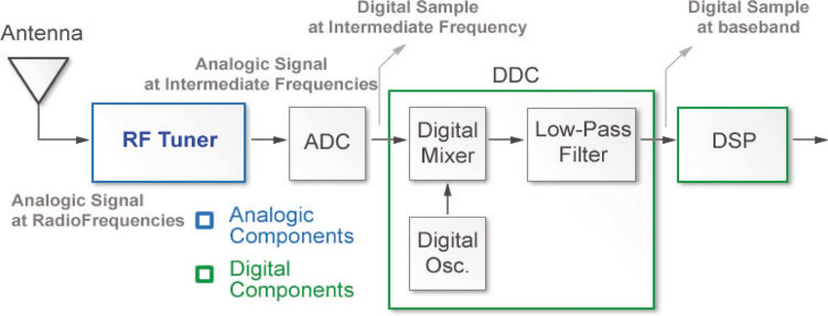
What is SDR?
“Software Defined Radio”
A radio in which some or all of the physical layer functions are software controlled
Notes:
Carter C

Slide 4
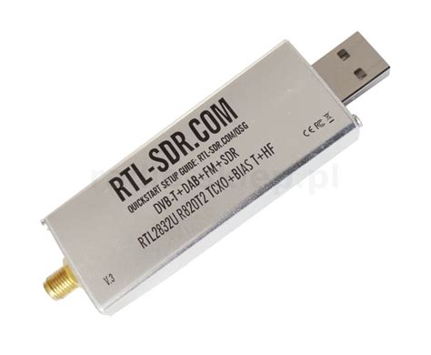
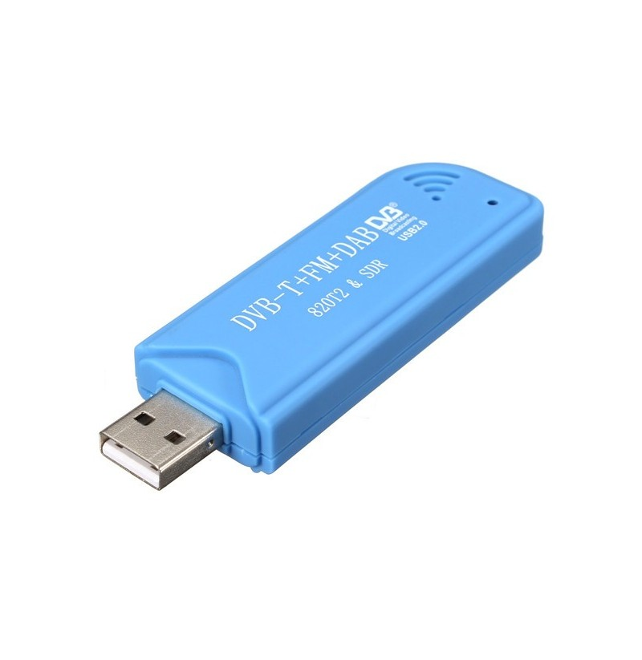
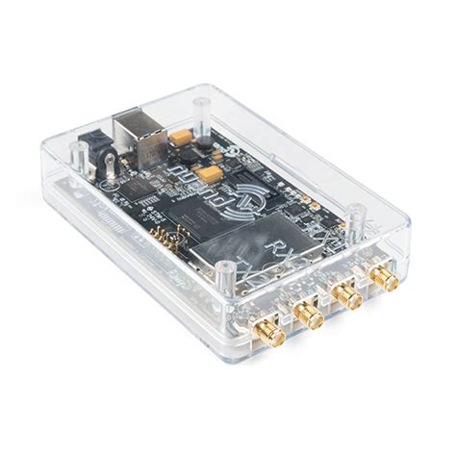
SDR Hardware
Cheap/Available through USB DVB-T Tuners
Higher end devices are available (BladeRF)
Modified DVB-T Tuners (RTL-SDR v3)
________________________________________
RTL-SDR v3 has many advantages
EM Shielding that is also a heat sink
High quality Thermal Correction Oscillator
Mixer allowing for up to 3.2Msps (2.4 stable)
Mixer allows for a band 24M-1766M Hz
Direct Sampling capable 500K-24M Hz
Notes:
Ryan E

Slide 5
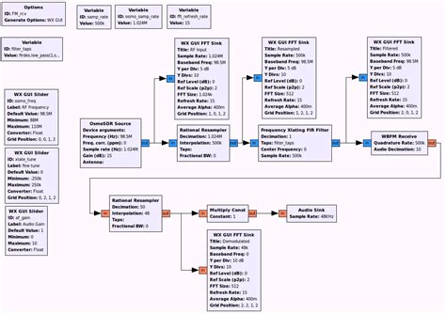
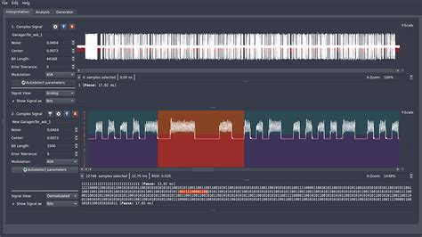
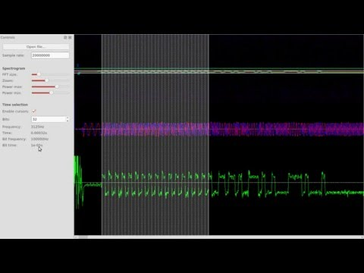
Open Source SDR Tools
GNU Radio - Software Development Toolkit providing signal processing to implement software defined radio and signal processing systems
Universal Radio Hacker - Suite for wireless protocol investigation
Inspectrum - analysis tool for captured transmission signals
Notes:
Ryan E

Slide 6
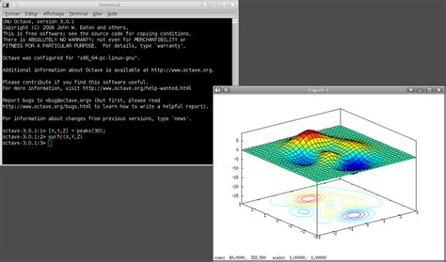
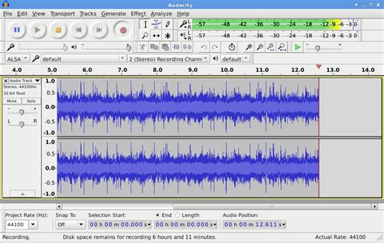
Useful non-SDR specific tools
Matlab/Octave - high level programming languages oriented toward numerical calculation
Audacity - digital audio editor and recorder
Notes:
Ryan E

Slide 7
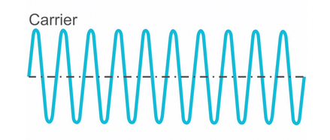
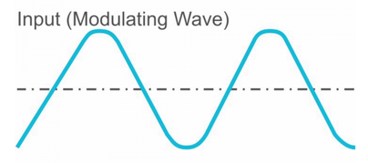
Modulation
Modulation is the act of imposing a message wave onto a carrier wave
The carrier wave has a constant frequency
The input signal is the message that we want to transmit
Notes:
Austin B

Slide 8
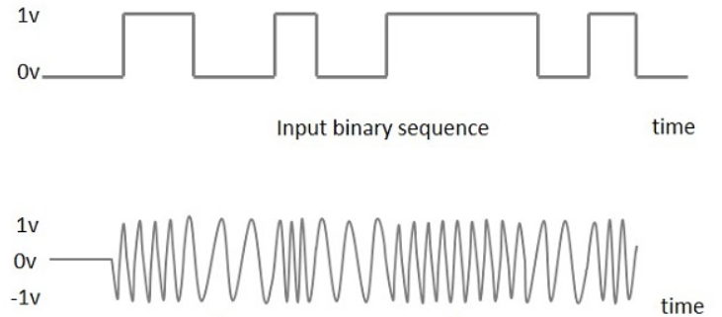
Frequency Shift Keying (FSK)
The output frequency changes based the input data
This is an example of 2-FSK (2 frequencies are used in the shift)
Notes:
Austin B

Slide 9
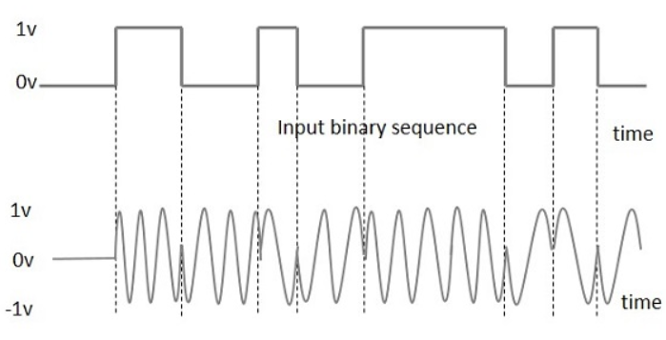
Phase Shift Keying (PSK)
Output phase changes based on the input
Below is an example of 2-PSK
Notes:
Austin B

Slide 10
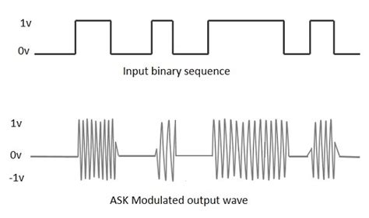
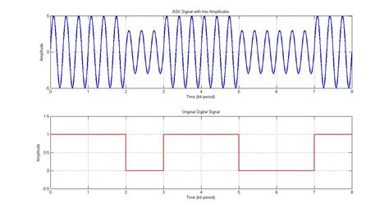
Amplitude Shift Keying (ASK)
Binary data is translated into changes in amplitude of the carrier frequency
Variations exist such as OOK (on-off keying)
Hybrid varieties like APSK (Amplitude-Phase Shift keying) are common
Notes:
Austin B

Slide 11
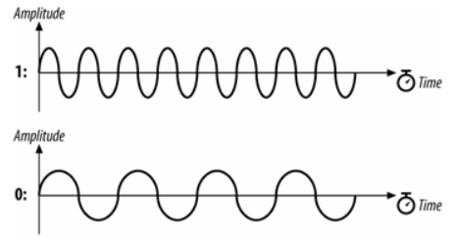
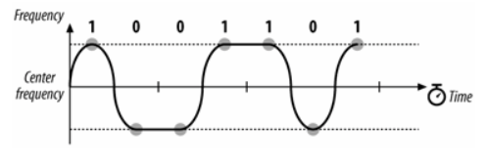
Gaussian Frequency Shift Keying (GFSK)
Uses a Gaussian filter to smooth transitions between frequencies
Reduces spectral bandwidth
Can increase intersymbol interference
Notes:
Austin B

Slide 12
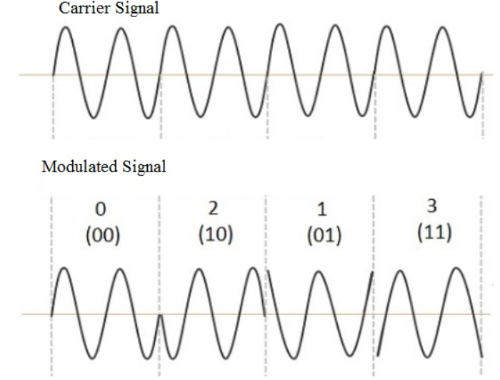
Quadrature Phase Shift Keying (QPSK)
Transmits two bits per symbol
Efficient in terms of bandwidth efficiency
Not as efficient in terms of power efficiency
Notes:
Austin B

Slide 13
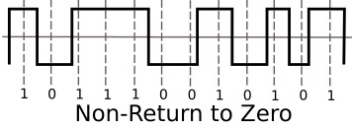
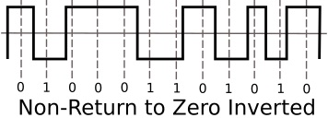
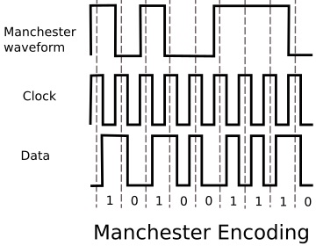
Encoding Refresher
NRZ (Non-Return to Zero)
Level matches the logical signal (data)
Commonly used in serial ports
NRZI (Non-Return to Zero Inverted)
Level matches inverse of the logical signal (data)
Manchester
Self clocking; Transitions at middle of each bit period
Logic 0 represented by 0->1 transition
Used by Ethernet
Notes:
Carter C

Slide 14
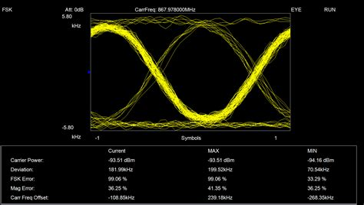
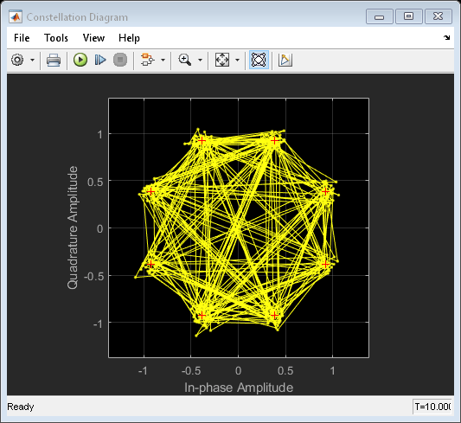
Eye & Constellation Diagrams
Eye Diagram - also known as an eye pattern, show range of amplitude and timing deviations associated with data bits
Constellation Diagrams - representation of a digitally modulated signal displayed on a 2D polar coordinate plane representing the complex values of the signal
Notes:
Carter C

Slide 15
Protocols
Protocols are pre established rules used to exchange information between two radio devices.
RF Protocols:IEEE 802.15.4, ZigBee, Z-Wave, Bluetooth
Other Protocols: IEEE 802.11, Packet Radio(AX.25)
Notes:
Daniel

Slide 16
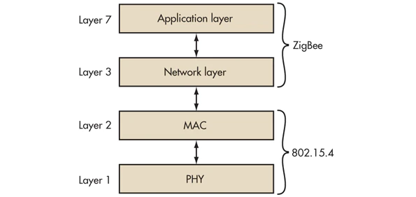
IEEE 802.15.4
Used as a base to be built on top of for many other RF protocols.
Frequency Ranges: 2.4GHz(most common), 868MHz, 915MHz
Uses PSK with speeds of up to 250kbps
Two Channel Access methods: Carrier-sense multiple access with collision avoidance (CSMA/CA), Time-division multiple access (TDMA)
Four Packet Frame Types:
Data
ACK
MAC Command
Beacon
Notes:
Daniel

Slide 17

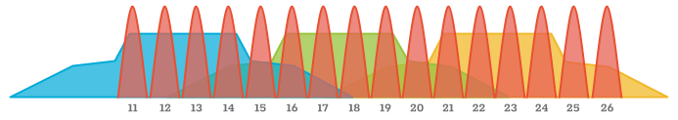
ZigBee
Built on top of IEEE 802.15.4
Typically operates at 2.4 GHz, but can also operate at 915 MHz in the US
Top speed is 250kbps
Subject to heavy interference from Wifi
Red is Zigbee signals, others is wifi
Uses direct sequence spread spectrum (DSSS) modulation which will reduce the overall signal interference
Notes:
Daniel

Slide 18

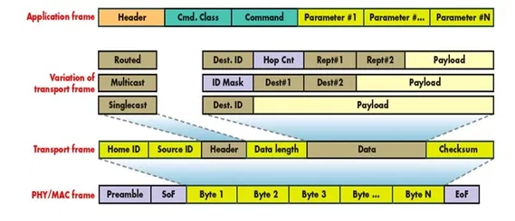
Z-Wave
Used in many smaller IOT devices
Z-Wave operates at 908.42 MHz in the United States and Canada
Creates a wireless Mesh Network of devices
Uses FSK with throughput of about 40Kb/sec - 100Kb/sec
Uses Manchester channel encoding or NRZ
Can apply AES128 encryption
Master and Slave Devices
Uses CSMA/CA on MAC layer
Notes:
Hunter

Slide 19
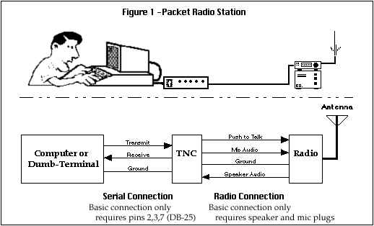
Packet Radio(AX.25)
Severely outdated, but used by many amateur radio users
Supported by linux use “sudo apt install ax25-tools” on Ubuntu
Data Link Layer Protocol
Not fast
Transmits using NRZI encoding
Notes:
Hunter

Slide 20
Works Cited/Useful Resources
https://www.rtl-sdr.com/
https://wiki.gnuradio.org/
https://www.rfwireless-world.com/
http://www.rtlsdr.com/
https://airspy.com/quickstart/
Notes:
Hunter

Slide 21
Key Fob Interception Demo
Ryan Eslick, Hunter Griffin
Notes:
Hunter

